Slide 1
President Biden has established the week of April 11 through 17 as
Black Maternal Health Week

Slide 2
Interesting facts
A Black mother with a college education is at 60 percent greater risk for a maternal death than a white / Hispanic/ Asian woman with less than a high school education.
In 2021, the maternal mortality rate for Black women was 69.9 deaths per 100,000 live births. With White women mortality being 26.6.
60% of pregnancy-related deaths are preventable.
For BIPOC causes of death include cardiovascular conditions in addition to cardiomyopathy, pre-eclampsia, and eclampsia (hypertensive disorders).
The Mother’s Autonomy in Decision Making (MADM) scale is a patient-led test that evaluates the experience of maternity care.
Women of color who have BIPOC doctors and/or doulas/midwives have better birthing outcomes
President Biden has established the week of April 11 through 17 as Black Maternal Health Week

Slide 3
Predictability of Medical Conditions from Social Media Posts
A Research Study Overview
Author: Raina M. Merchant et al.
Published: June 17, 2019

Slide 4
Key points
Purpose of study: To explore the predictability of medical conditions from social media posts.
Background: Leveraging social media for insights into health trends and risks.
Participants: 999 individuals with social media and EMR data.
Analysis: Natural Language Processing and Machine Learning to analyze Facebook posts.

Slide 5
Findings
Specific Conditions: Effective prediction of diabetes, anxiety, & depression.
Linguistic Markers: Identification of key words and phrases linked to specific conditions.
Key Findings: Social media content can predict 18 out of 21 medical conditions studied.
Enhancement with Demographics: Adding demographic data improves prediction accuracy.

Slide 6
Implications
Impact: Demonstrates the potential of social media data in health research.
Integration: Encourages further integration of digital data sources in medical studies.
Contribution to Personalized Medicine: Potential for tailored health interventions.
Social Media Data Use: Use social media data to determine disease onset or exacerbation and to conduct social media-based health interventions.

Slide 7
Questions & Answers
For further inquiries, please contact:
Email: raina.merchant@uphs.upenn.edu

Slide 8
Findings
For example, alcohol abuse was marked by a topic mentioning drink, drunk, bottle.
Topics expressing hostility (e.g. people, dumb, bulls**t, b**ches) were the predominant marker of drug abuse and also marked psychoses.
Topics most associated with depression suggested somatization (e.g. stomach, head, hurt) and emotional distress (e.g. pain, crying, tears).
Other markers may suggest socio-environmental variables associated with disease risk; for example, diabetes was predicted by religious language (e.g. god, family, pray) even when controlling for demographic variables

Slide 9
***This does not mean that everyone mentioning these topics has the condition, but just that those mentioning it are more likely to have it.*** For example, the top 25% of patients mentioning the (god, family, pray) topic were 15 times more likely to have been diagnosed with diabetes.

Slide 10
Questions & Answers
For further inquiries, please contact:
Email: raina.merchant@uphs.upenn.edu

Slide 11
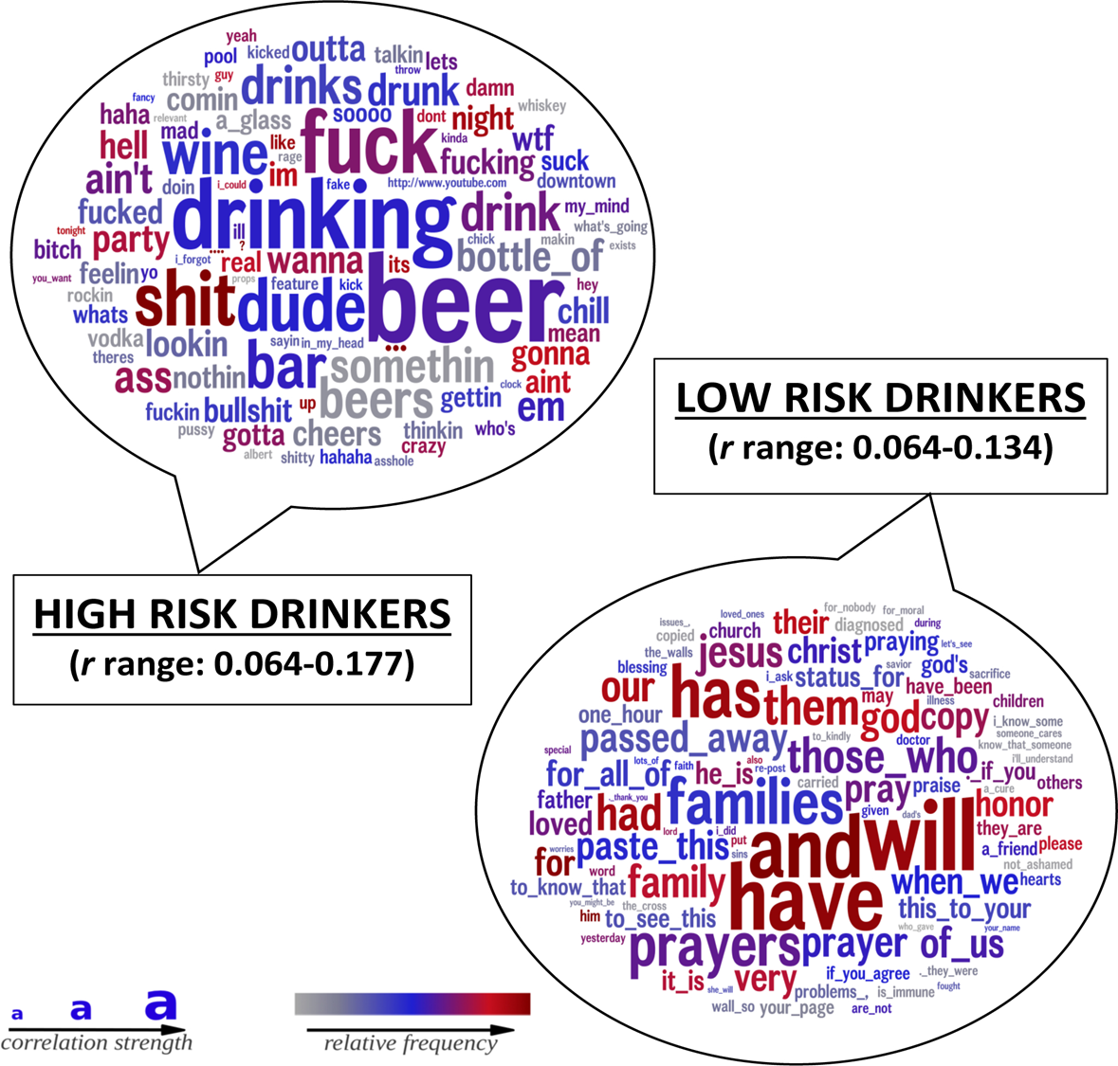
ALCOHOL and SOCIAL MEDIA

Slide 13
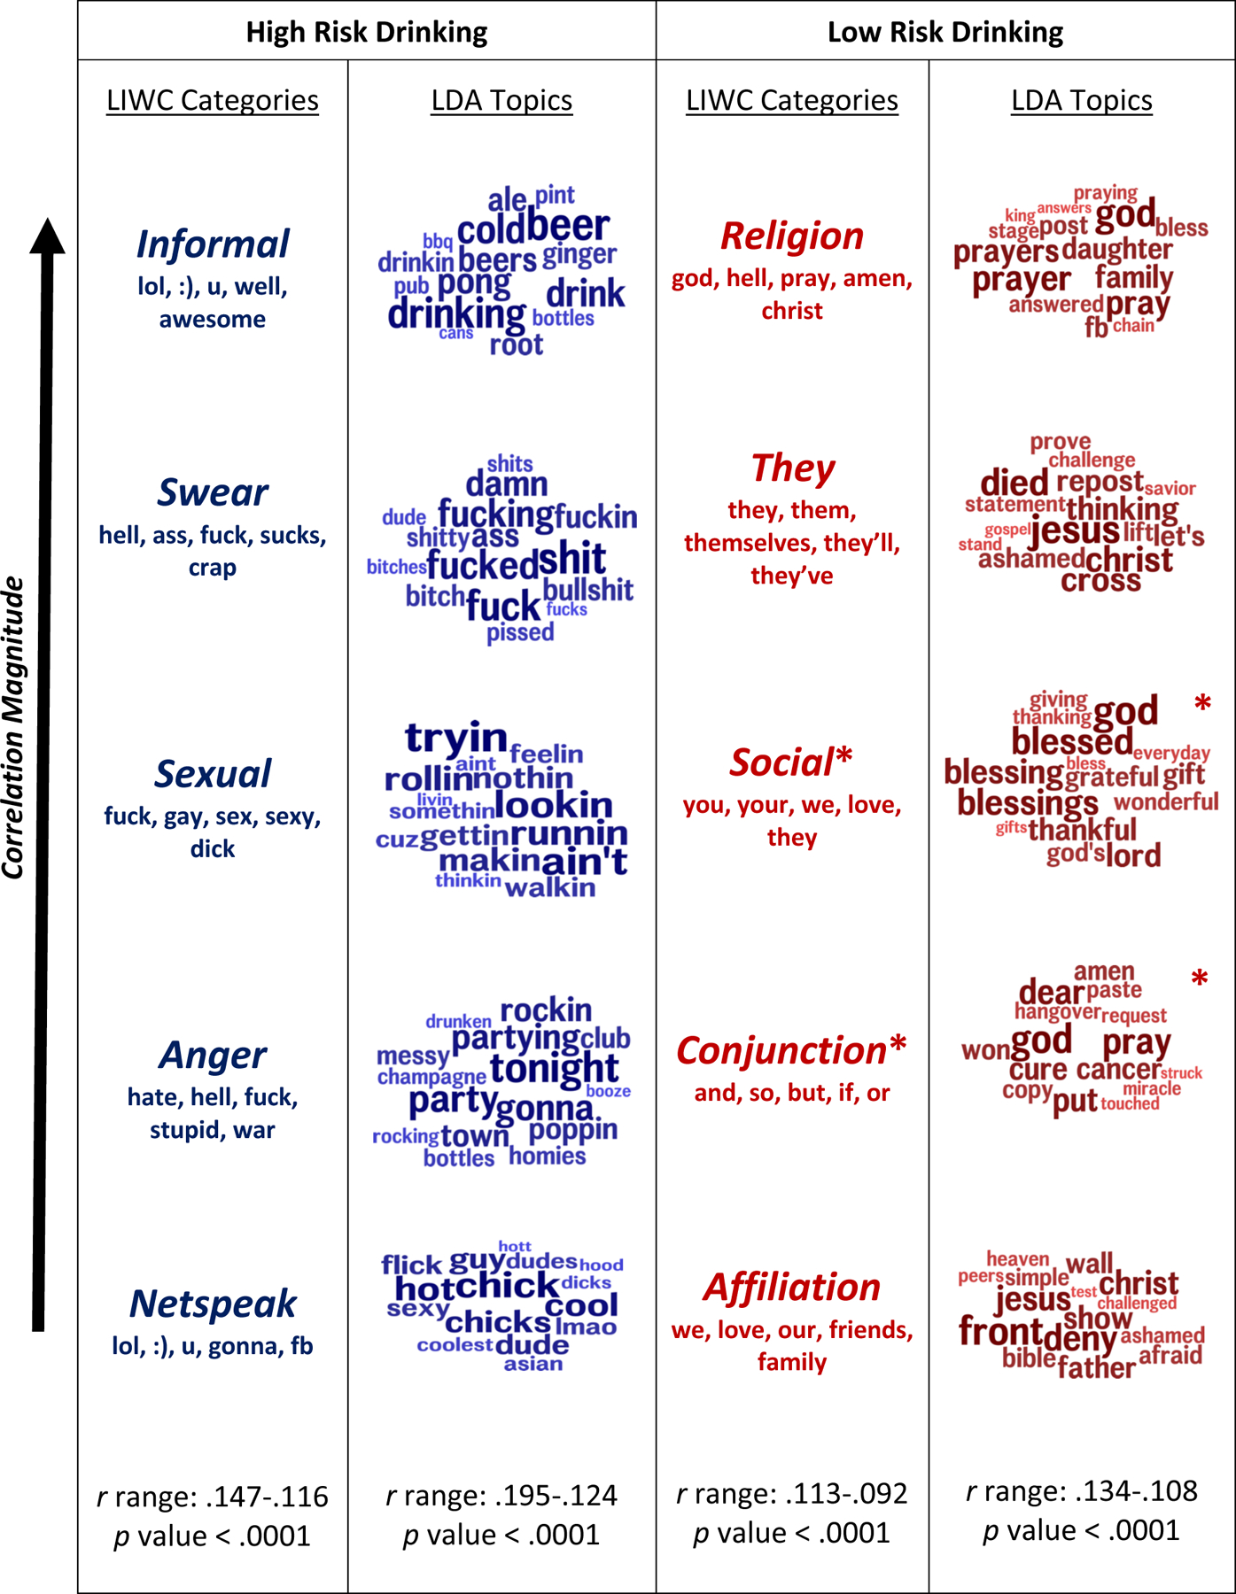

Slide 14
High-risk alcohol use predicted by words related to alcohol, partying, and anger. Low-risk alcohol use associated with social, affiliative, and faith-based words.

